Slide 1
STATG019 – Selected Topics in Statistics 2015 Lecture 3
Learning with Gaussian Processes
Dr Franz J. Király

Slide 2
Course organization
Lecture schedule
Simon will start next week with point processes
Likely plan: 2 or 3 lectures on point processes, then kernels again
Are you fine with an ICA on the content of the first three kernels lectures?
(so you will not have to worry strategically about which topics to choose)
Voting about further kernels topics in the coming weeks.
Feel free to suggest topics that interest you!
Tutorials and/or practical sessions
Thursday, 11am - 1pm , January 29
Gordon Square 16-18, room 101
Tutorial will be mainly on kernlab with R and feature maps
Please install R and kernlab on your laptops (cluster rooms are full)
Informal schedule: no frontal teaching, questions are very welcome

Slide 3

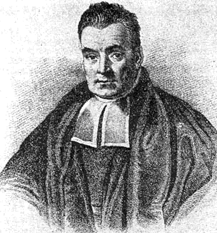


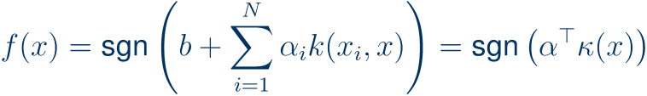

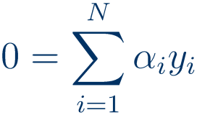

Are kernels for the frequentist only?
Support vector machines, ridge regession etc allow non-linear regression and classification
Kernel ridge regression:
Kernel SVM:
s.t.
Both formulations are discriminative and non/probabilistic
Is there a way to include prior information on data samples?
Bayesian inference?
Confidence intervals?
Estimation of kernel parameters?

Slide 4
Gaussian Processes

Slide 5


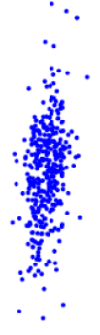







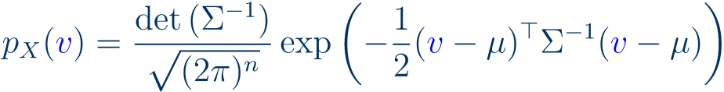









(multivariate) Gaussian random variable
Gaussian process
outcomes/realizations are vectors
outcomes/realizations are functions
possible definition:
possible definition:
another possible definition:
another possible definition:
classical result (immediate from definition 1):
classical result (by using properties of mgf):
“mean vector”
“covariance matrix”
“mean function”
“covariance function”

Slide 6





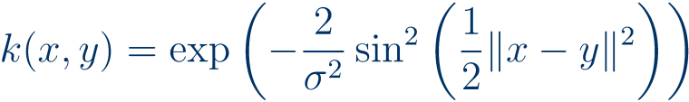
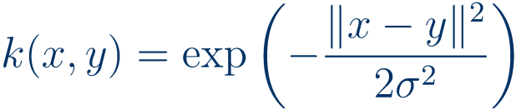
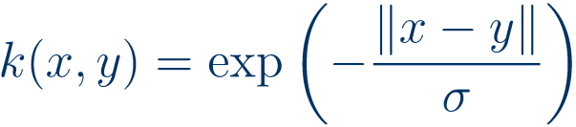
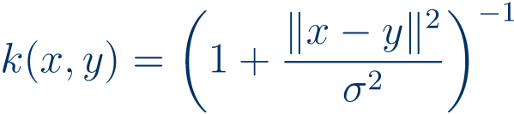



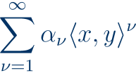


A (non-exhaustive) list of popular covariance functions
constant covariance
Gaussian noise
linear covariance function
Distance covariance functions
Dot-product covariance functions
Periodic covariance function
Squared exponential covariance function
Ornstein-Uhlbeck covariance function
Rational quadratic covariance function
Proposition:
(in case of convergence)
(in case of existence)

Slide 7

An exhaustive list of popular mean functions
Non-zero mean is usually application-specific when used,
it encodes prior knowledge on the possible outcome functions.
In application where there is only one sample of a process
- as in the following- the mean function cannot be reliably estimated, thus setting it to zero is scientifically parsimonious in the absence of further prior knowledge.

Slide 8
Gaussian process regression

Slide 9


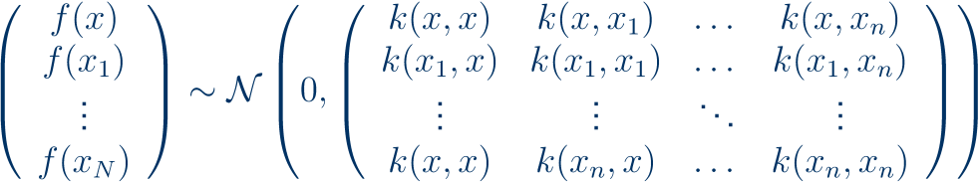


Interpolation
Regression with Gaussian processes
Main assumption:
Mathematical/statistical idea:
by main ass.
Bayes’ theorem:
“covariance matrix”
An elementary though tedious computation yields:
“cross-covariance vector”
Bad news:
overfits horribly

Slide 10







Regression with Gaussian processes
Main assumptions:
Equivalently:
with
s.t.
By additivity of variance:
So regression with noise can be reduced to interpolation!
Substitution into previous equations yields, for posterior:
where
thus posterior is
where

Slide 11



On error and parameter estimation
Remark 1:
Remark 2:
Then
Remark 3:
The probabilistic viewpoint allows to find best parameters via the following
Methods:
Maximum likelihood, maximum-a-posteriori, posterior expectation
Log-likelihood:
with
Bayes posterior:
“characteristic polynomial”
“prior”
Optimization and integrals require numerical methods…
Bayesian prediction:

Slide 12
Kriging

Slide 13
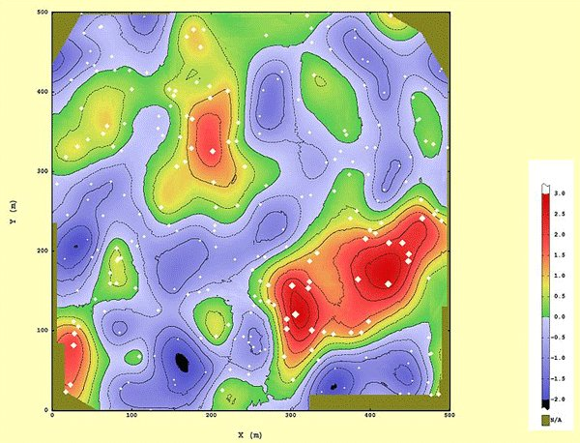





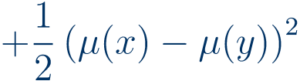
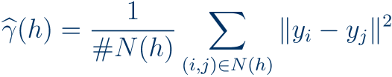
Kriging
(after D.G. Krige’s master’s thesis, 1951)
Mathematically identical to GP/ridge regression and Gaussian process prediction, with a few differences:
Application
predominantly in geostatistics to find ore, oil, gold, etc
Interpretation
as error minimizing prediction for specific point processes
Mean functions
polynomial
known, or unknown
“ordinary kriging”
“universal kriging”
The variogram
“empirical variogram”:
where
then regression is applied.

Slide 14
Gaussian process classification

Slide 15






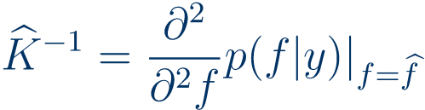
Classification with Gaussian processes
Regression:
learn a regressor
Classification:
learn a classifier
Idea 1:
estimate
Idea 2:
Good news:
idea 2 works, for example with
in this case,
Bad news:
Solution idea:
an elementary computation yields
so approximately

Slide 16
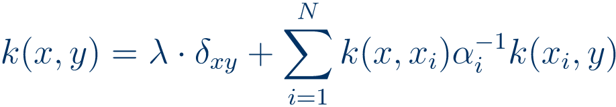



The Relevance Vector Machine
= Gaussian process regression/classification
with covariance function:
with i.i.d. hyperpriors:
with specific optimization updates including expectation maximization
and a US patent (US 6633857) granted to
… so it is not available in kernlab.
Implementing the covariance function above and invoking gausspr with the above parameters may constitute, under certain circumstances, patent infringement as defined by US patent law

Slide 17
Using Gaussian processes in kernlab

Slide 18

Gaussian processes in kernlab
gausspr offers regression and classification with Gaussian processes
usage for training:
gprmodel <- gausspr(vartopredict~.,data=traindata,…)
trains a predictor, stored in the output variable gprmodel of type gausspr
important parameters for gausspr:
type
"classification" or "regression"
kernel
determines the kernel used, e.g. "rbf-dot"
kpar
a list of kernel parameters, e.g. list(sigma=1)
var
noise variance for i.i.d. Gaussian noise
output contains model parameters as alpha
"regression" is equivalent to ridge regression with regularizer var
usage for prediction:
predicted <- predict(gprmodel, testdata)
yields a vector predicted of predictions for testdata
Documentation: http://cran.r-project.org/web/packages/kernlab/kernlab.pdf
Type help(gausspr) or example(gausspr) for more details and examples

Slide 19
Outlook
Lecture 1: Introduction to kernels
Main concepts and theoretical results, learning guarantees
Kernel PCA and kernel ridge regression
Some notes on R and kernlab
Lecture 2: the kernel support vector machine
The linear support vector machine, duality
Hard- and soft-margin two-class SVM
The one-class SVM
Support vector regression
Lecture 3: Gaussian processes and kernel learning
Potential further lecture topics:
Algorithms: kernel discriminants, kernel k-means, kernel quantile regression kernel CCA, kernel MMD, kernel relevance vector machine
Large-scale learning with kernels, subset methods and Nyström-approximation
Combinatorial kernels: string kernels, graph kernels
Invariance kernels
Vapnik-Chervonenkis learning theory
Outlier detection, novelty detection
On-line kernel learning

Slide 20
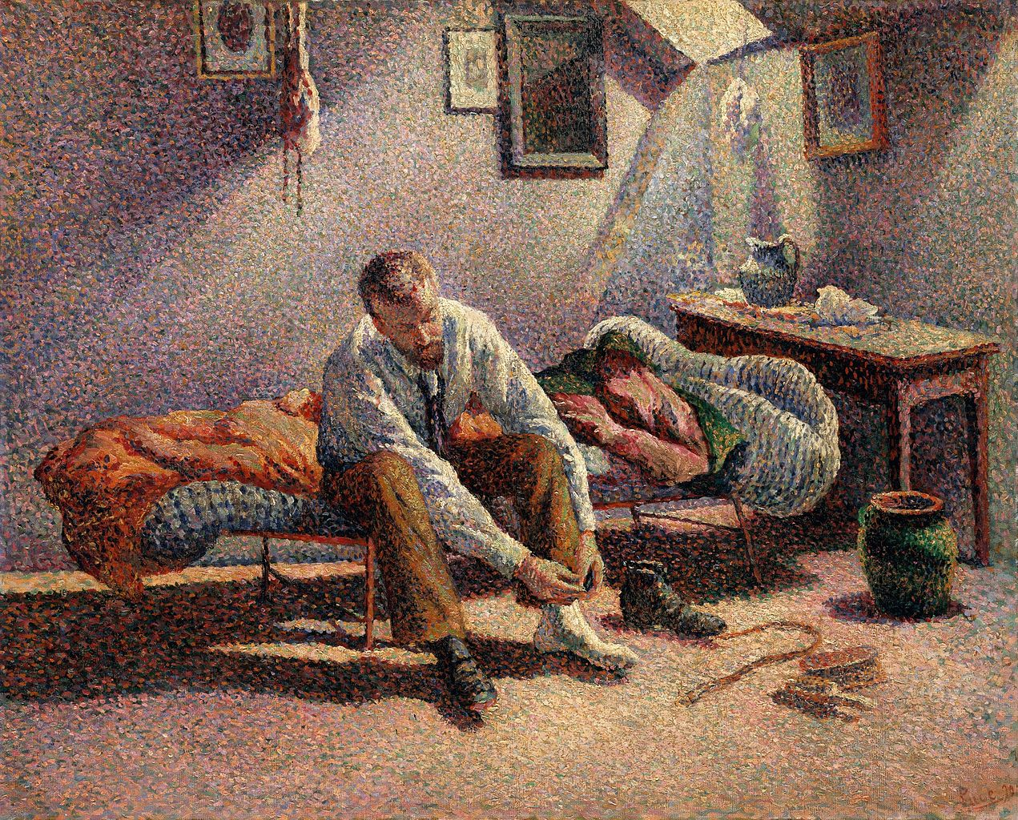
Next week:
Point Processes
(Simon)

